Slide 1

Fix-a-Failure
Improving the Articles of Confederation

Slide 2
Articles of Confederation
After winning our independence from Great Britain in the Revolutionary War, the new country needed to develop some form of governmental system.
Many wanted to be free of a strong central government. They saw themselves first as citizens of their states as opposed to the nation. States’ rights were an important issue.
The Articles of Confederation represented the first constitutional agreement made between the 13 American states. There was a need for unity among the new states that were created as a result of the American Revolution.
Ben’s Guide to Government

Slide 3

Confederation
The United States began as a confederation.
A confederation is…
  A group or league of independent states or nations united for a common purpose
The Articles of Confederation created a nation of pre-existing states rather than a government over individuals.

Slide 4
Articles of Confederation
Under the Articles of Confederation, the state governments retained most of the power.
The central or national government commanded little respect and was not able to accomplish much because it had little jurisdiction/power over states or individuals.
States
Nat’l Gov.

Slide 5
Problems with the Articles of Confederation
Under the Articles of Confederation, states often argued amongst themselves.
  They also refused to financially support the national government.
  The national government was powerless to enforce any acts it did pass.
  Some states began making agreements with foreign governments.
  Most had their own military.
  Most states printed their own money. There was no stable economy.

Slide 6

Shays’ Rebellion
A postwar depression had left many small farmers unable to pay their debts and threatened with mortgage foreclosures.
In western Massachusetts, a small band of farmers led by Captain Daniel Shays undertook a series of armed attacks on courthouses to prevent judges from foreclosing on farms.

Slide 7
Shays’ Rebellion
Shays’ Rebellion was the fiercest outbreak of public discontent in the new nation and demonstrated the weaknesses of the Articles of Confederation.
The rebellion convinced many states of the need for a stronger central government.

Slide 8
Change is Needed
As the economic and military weaknesses became apparent, people began asking for changes to the Articles of Confederation that would create a stronger national government.

Slide 9
Philadelphia Convention
At the urging of the states, Congress invited delegates from all of the states to Philadelphia
The purpose of this meeting was “for the sole and express purpose of revising the Articles of Confederation”
  Delegates (representatives of the states attending the convention) were only to revise the Articles…
  …but did they do more than revise?
Notes:
The delegates to the Convention, which was a confidential conference, would throw out the Articles of Confederation to write the United States Constitution.

Slide 10
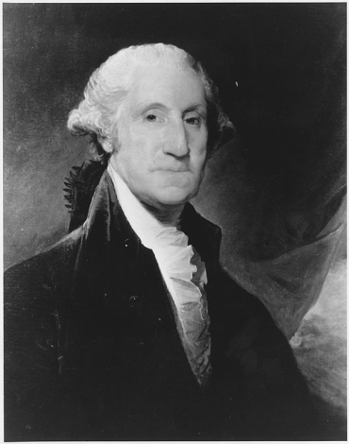
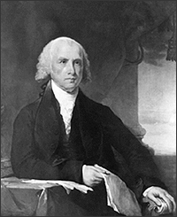
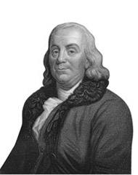
Philadelphia Convention
Who was there?
  55 delegates to the Philadelphia Convention
  All were white , male, landowners
  Delegates included:
  Benjamin Franklin – one of the most respected men in America; primary role at the convention was to encourage cooperation among the delegates
  James Madison – had a plan for a stronger national government; the “Father of the Constitution”
George Washington – highly respected; believed in a strong national government
Photos from www.archives.gov
Notes:
Discuss who was at the Philadelphia Convention. The 55 delegates were composed of white, male landowners – some of whom possessed above average wealth. Groups not represented were women, slaves, and Native Americans.

Slide 11

Philadelphia Convention
Met for four months in 1787
Proceedings held in secrecy
Problems with Articles of Confederation were so great that the document was abandoned.
All states received one vote at the convention
  This was done to please the small states who felt it was unfair to give more votes to the larger states
Those who attended would be known as the “Framers,” as they would be the ones to create the framework of the United States government in the Constitution.
Notes:
Discuss the main ideas the delegates had going into the Philadelphia Convention. They were aware they would not be “revising” the Articles of Confederation, but writing an entirely new constitution.
The proceedings were kept a secret so those inside the convention felt they could speak freely, not be impacted by outside opinion, and so the public could not see the arguments that took place during the writing of this document. Many felt if the general public knew the conflicts behind the document, the public would not support something that was so potentially divisive.
Small states wanted equal representation at the convention, thus the one state, one vote system. The small states threatened to leave if the larger states were given more votes.
Discuss the title of “Framers” given to the delegates of the Philadelphia Convention.

Slide 12

Article Failures
Problem
Congress could not collect taxes.
  No taxes=no money to run the country.
  States would not support the national government.
Implication
X
X
X
Notes:
Answer: States would not support the national government. Without taxes there was no way to fund public services and the national government. Ask students to identify the types of services
Question for discussion: What would the United States be like if we were missing all of these things?

Slide 13

Article Failures
  National government was powerless to enforce any laws it passed;
  No President
  No checks and balances
Problem
There was no separate executive branch for the central government
Implication
?
Notes:
Answer: The United States would have no Commander in Chief of the military, ambassadors (representatives of the United States) to other countries, updates on the state of government, ability to override the laws of the legislative branch, appointment of judges to federal or the U.S. Supreme Court (neither of which would exist under the Articles).

Slide 14


Article Failures
Problem
Congress had no power to enforce its own laws in the states
  No enforcement=people in various states doing what they want
Implication
Notes:
Answer: Laws that impact the whole country would have no value if they were not enforced. For example, the requirement to pay taxes to the federal government would have no value under the Articles of Confederation.
Side note: there was no power to tax in order to fund law enforcement. This also made the enforcement of laws difficult to impossible.

Slide 15
Article Failures
  States had their own trading practices and regulations with other states. This created slow and tense trade relationships.
Problem
National government could not regulate trade between states.
Implication
Notes:
Answer: State trade relationships would be very tense. States could set their own regulations and taxes thus creating slow and expensive processes for trading, certain states might set a ban on trading with other states, states could prohibit the movement of goods through their state (creating geographical trade issues)

Slide 16
Article Failures
  States were entering individually into trade agreements with foreign nations.
Problem
Congress could not regulate foreign trade/commerce.
Implication

Slide 17

Article Failures
Problem
Citizens in states thought their property rights were being violated
  Violated property rights = tension between state governments and the people
Implication
X
Notes:
Answer: Without the national government protecting the property rights of the people, the states could have the power to manipulate policy to benefit those in the majority and forget about those in the minority. This would lead to corruption in government, people being stripped of their rights, and discrimination against those not in power. Without a national government to check the power of the state government

Slide 18
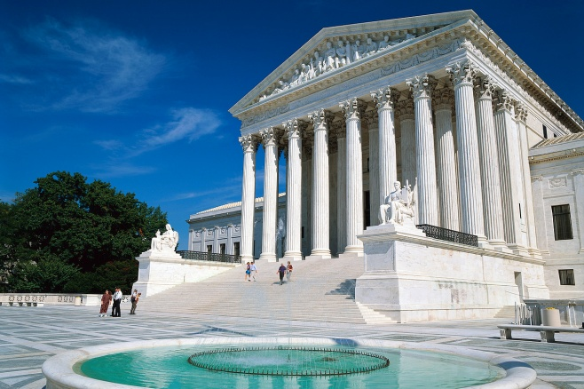
Article Failures
  No court system to handle national/federal level issues
  Interstate issues would have no courts to go to on the federal level
  Federal laws but no federal courts?
  No checks and balances
Problem
There was no separate, national court system
Implication
MISSING
Notes:
Why could this be a problem even if the states had their own courts?

Slide 19
Article Failures
Problem
The Articles required a unanimous vote to make changes to the Articles
  This made it nearly impossible to make changes to the Articles; it could not be changed to match the current needs of the people
Implication
Notes:
Answer: None of the amendements to the United States Constitution have ever passed with a unanimous vote. The exercise on the slide will show students which amendments we would be missing if it was required to have a unanimous vote to amend the U.S. Constitution.

Slide 20
On Top of All Those Issues…
There were other looming issues facing the Framers:
  How would representation be addressed in the new constitution? Would large and small states all have the same voting power?
  How would the issue of slavery be addressed in the new constitution? Would slaves count towards the population of a state?
  How much power would be given to each branch of government?

Slide 21
Options
How did the Founders correct the problems in the Articles of Confederation?
  They tossed the Articles and started over!
    Options considered:
Virginia Plan
New Jersey Plan
Proposed a strong national government
State and national governments would exist, receiving their power from the people.
National government would make and enforce their own laws and could tax the people
Would have legislative (with a House and Senate), executive and judicial branches.
Proportional representation
Proposed a weak national government
Congress could collect taxes on products and collect fines from the states if they refused to pay their taxes.
Congress would have one house/chamber
Each state would have equal representation

Slide 22
SCAVENGER HUNT!
Your mission:
  Hunt through the United States Constitution to find how the Framers fixed the problems presented by the Articles.
  Write where you found the “fix” - Article and Section Number and/or Amendment Number. You might find answers in more than one place!
  Then write a summary of what you found in the Constitution that fixed the problem

Slide 23
Fix-a-Fail
How did the Constitution Fix the Failing Articles?

Slide 24



Fix-a-Failure
Problem
Congress could not collect taxes.
  No taxes=no money to run the country
How did the Constitution fix this problem?
Article I, Section 8, Clause 1
“To lay and collect taxes…”
Translation: Congress has the power to set and collect taxes from the people.
X

Slide 25
Fix-a-Failure
How did the Constitution fix this problem?
Problem
There was no executive branch for the central government.
Article II, Section 1 “The executive Power shall be vested in a President of the United States of America”
Translation: The power to execute the law will belong to the President of the United States of America.
?
Notes:
Central and national government is used interchangeably

Slide 26
Fix-a-Failure
How did the Constitution fix this problem?
Problem
Congress had no power to enforce its own laws in the states.
Article II, Section 3
“…he shall take Care that the Laws be faithfully executed…”
Translation: The duty of the executive branch is to make sure the laws are carried out/enforce.
Notes:
Add other citations

Slide 27
Fix-a-Failure
How did the Constitution fix this problem?
Problem
Congress could not regulate trade between the states.
Article I, Section 8, Clause 3
“…to regulate Commerce…among the several States…”
Translation: Congress has the power to regulate trade between the states.

Slide 28

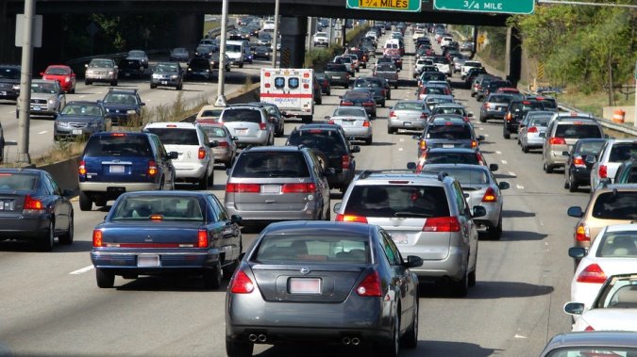

Fix-a-Failure
Problem
Congress could not make states follow trade agreements with other nations
How did the Constitution fix this problem?
X
Article I, Section 8, Clause 3
“To regulate commerce with foreign Nations…”
Translation: Congress has the power to regulate trade with foreign countries.

Slide 29
Fix-a-Failure
Article VI
“This Constitution…shall be the supreme Law of the Land…”
Translation: No laws are above the Constitution; states should not make laws that conflict with the Constitution.
Problem
Citizens in states thought their property rights were being violated
How did the Constitution fix this problem?
X
Amendment IV
“The right of the people to be secure in their persons, houses, papers, and effects against unreasonable searches and seizures…”
Translation: The government cannot unfairly search personal property.
Notes:
Discuss eminent domain…

Slide 30
Fix-a-Failure
How did the Constitution fix this problem?
Problem
There was no national court system
Article III
“The judicial power of the United States shall be vested in one supreme Court, and in such inferior Courts as the Congress may from time to time ordain and establish.”
MISSING
Translation: The Supreme Court is the highest court in the nation and there are lower courts that are created by Congress

Slide 31
Fix-a-Failure
Problem
The Articles required a unanimous vote to make changes to the Articles
How did the Constitution fix this problem?
Article V “The Congress, whenever two thirds of both houses deem it necessary, shall propose Amendments to this Constitution…shall be valid…as Part of this Constitution when ratified by the Legislatures of three fourths of the several States or by Conventions in three fourths thereof…”
Translation: The Constitution can be changed if 2/3 of both houses of Congress think it’s necessary. It will be valid as part of the Constitution if ¾ of the state legislatures agree.

Slide 32
Representation
Small States
Large States
Feared large states would have more power if they were given votes based on population.
Wanted one vote per state.
Felt their interests would not be properly represented with one vote per state.
Wanted “proportional representation” or representation based on population.
The Great Compromise (AKA The Connecticut Compromise)
In order to appease both large and small states, the compromise was a bicameral legislature, or a legislature divided into two chambers: one with two representatives from each state (equal representation) and one with representation based on population (proportionate representation ).
Notes:
See Article I Sections 1-6 and the 17th Amendment

Slide 33
Slavery
Northern States
Southern States
Most were opposed to slavery
Many were concerned about the Southern states counting slaves as part of their population thus giving them more representation in Congress.
Some were opposed to slavery, but many were financially dependent on slavery for farming purposes.
Believed that each state should have the right to choose for themselves. Without this choice, Southern states would not agree to be part of the union.
The Compromise:
The Framers agreed that the slave trade would not be ended prior to 1808. They also decided on the three fifths clause stating that population for the House of Representatives would be based on the total of free persons, indentured servants, and 3/5 of the slave population.

Slide 34
Power Struggle
Here is an example of checks and balances in action:
Executive Branch – Enforces the law
Concerns arose about how much power each branch of government would be given.
Each branch of government would be given certain powers outlined in the Constitution.
In addition to those powers, each branch would be given certain “checks” they could do on the other branches of government.
For example:
The President has the power to veto bills proposed by Congress.
Legislative Branch – Makes the law
Judicial Branch – Interprets the law
Legislative branch can pass a bill over the President’s veto with enough votes; may also re-word proposed bill and reintroduce
The Supreme Court has the power of judicial review allowing them to declare laws of Congress or acts of the President unconstitutional.

